Slide 1
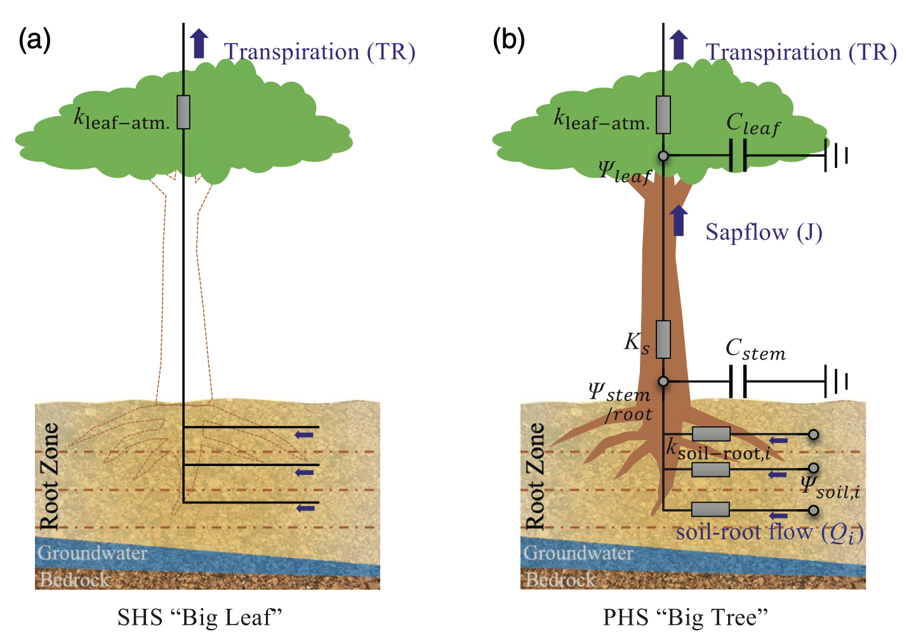
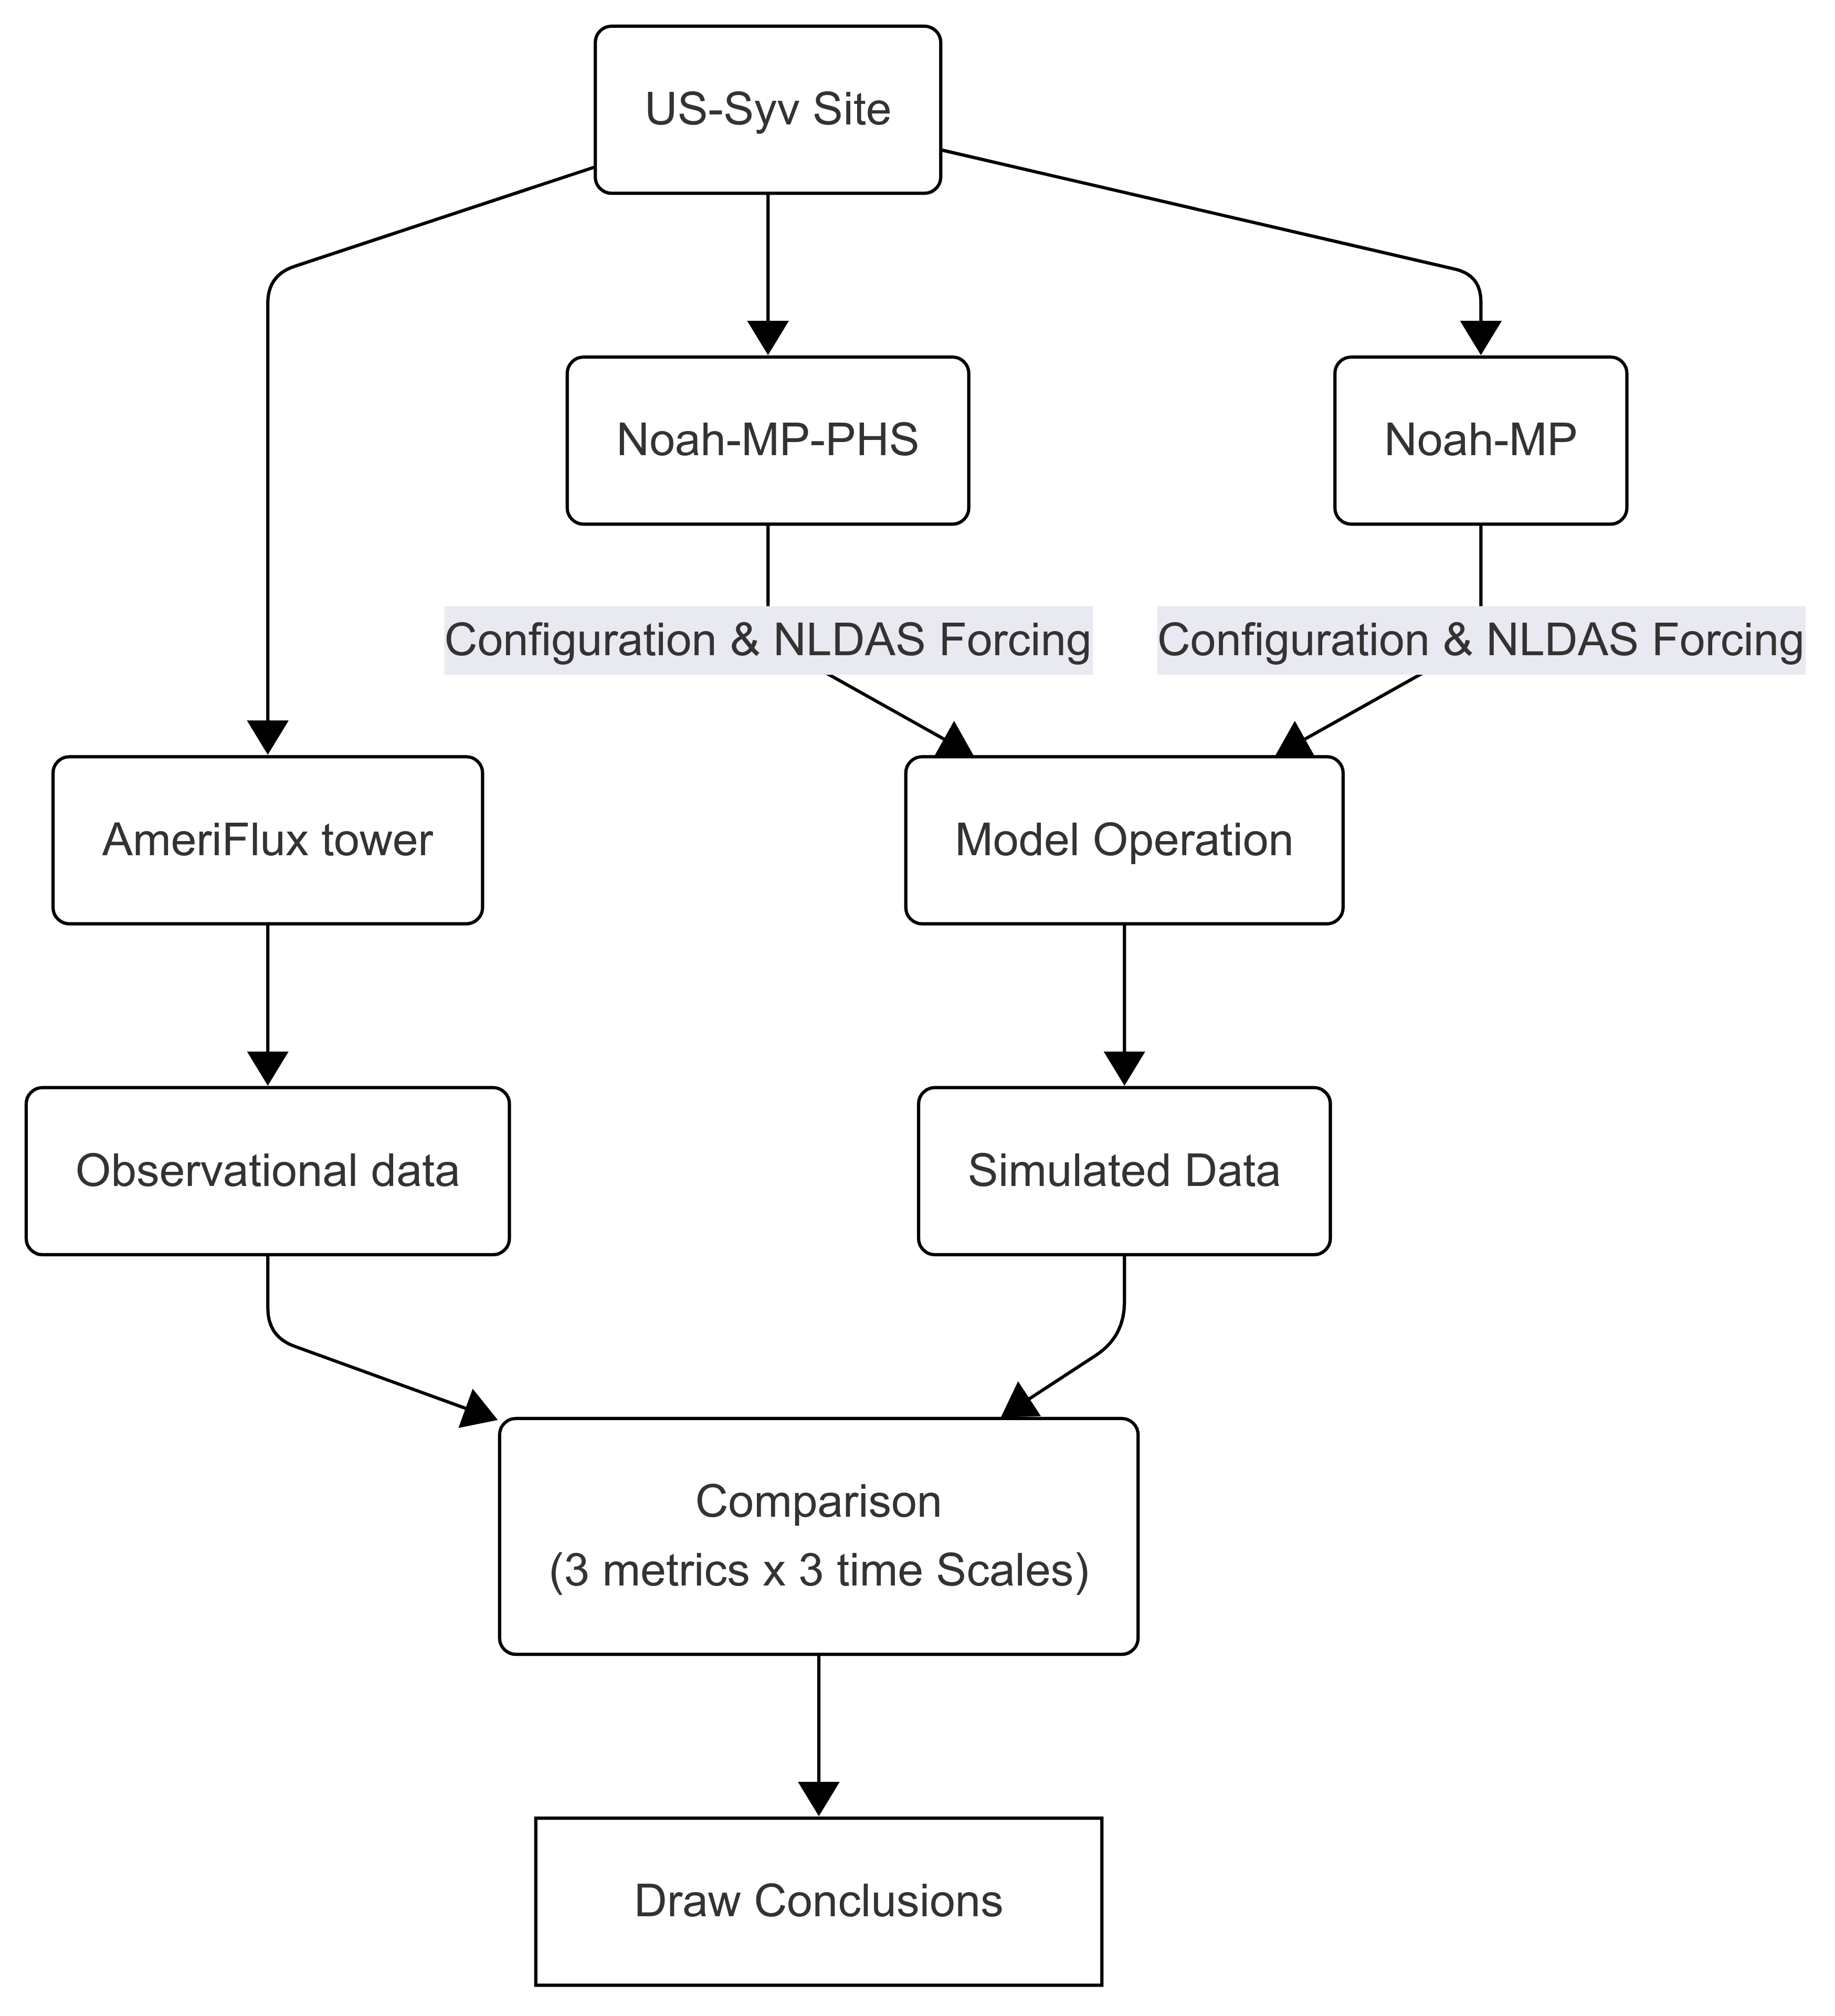
“Big Leaf” vs. “Big Tree”:
Does the Big Tree model better represent reality?
“Big Leaf”
Soil moisture
→
Carbon, water, energy simulations
→
Uncertainties
“Big Tree”
Soil moisture
<add> whole-plant hydraulics
→
Carbon, water, energy simulations
→
Uncertainties expect to reduce
Difference between the “Big leaf” and “Big tree” approach (extracted from Li et al., 2021).
Most land surface models, e.g.,
Noah-MP
New land surface models, e.g.,
Noah-MP-PHS
Notes:
Introduction to a Key Concept in Land Surface Modeling: “Big Leaf” vs. “Big Tree”
Hi everyone! Today I’ll introduce a basic concept in land surface modeling: the difference between the “Big Leaf” and “Big Tree” approaches. This idea is important because it affects how we simulate water and carbon movement through ecosystems — which is critical for understanding droughts, agriculture, and climate change.
1. Start with a Simple Analogy
Think of a plant as a machine that moves water from the soil to the atmosphere and uses carbon from the air to grow. To simulate how this works, scientists use computer models. But how detailed these models are can make a big difference.
2. What is the "Big Leaf" Concept?
Most traditional land surface models, like Noah-MP, use what we call the "Big Leaf" concept (left side of the diagram).
Imagine all the plant leaves are combined into one big leaf.
This big leaf responds directly to soil moisture, meaning how wet the ground is.
It doesn't include the inner structure of the plant like stems or roots.
It uses empirical formulas — kind of like guessing based on past observations — to simulate how much water the plant loses and how much carbon it takes in.
Problems?
It oversimplifies how plants actually move water.
It introduces uncertainties, especially during droughts or extreme conditions.
3. What is the "Big Tree" Concept?
Now look at the right side of the diagram. The "Big Tree" approach, used in a new version called Noah-MP-PHS, adds whole-plant hydraulics.
This means:
Water is tracked all the way from the soil → through roots → up the stem → to the leaves.
It includes physical properties like:
Root and stem conductance (how easily water moves),
Stem and leaf capacitance (how much water they can hold temporarily),
Sap flow, which is the actual movement of water inside the plant.
By modeling the full path of water, from soil to air, we reduce the uncertainties in simulating how plants behave under stress.
4. How Do We Test These Models?
On the far right of the diagram is a flowchart showing how we test if the new model works:
We use a real-world site (US-Syv) and collect data from instruments like the AmeriFlux tower, which tells us how much water and carbon are going in and out of the ecosystem.
We run both models: Noah-MP and Noah-MP-PHS.
We compare model outputs to the observed data, using three metrics across three timescales.
Then we draw conclusions: does the Big Tree model better represent reality?
5. Why Does This Matter?
Understanding how plants interact with water is crucial for predicting drought impacts, managing agriculture, and forecasting climate change. The Big Tree model gives us a more realistic tool to simulate what’s happening in nature.
Closing
So, to summarize:
Big Leaf is simple but introduces uncertainties.
Big Tree is more realistic by modeling full plant water transport.
New models like Noah-MP-PHS aim to reduce simulation errors and improve predictions.
Ready for Questions
Now that you’ve seen the concept, I’d be happy to answer any questions you have!

